Slide 1
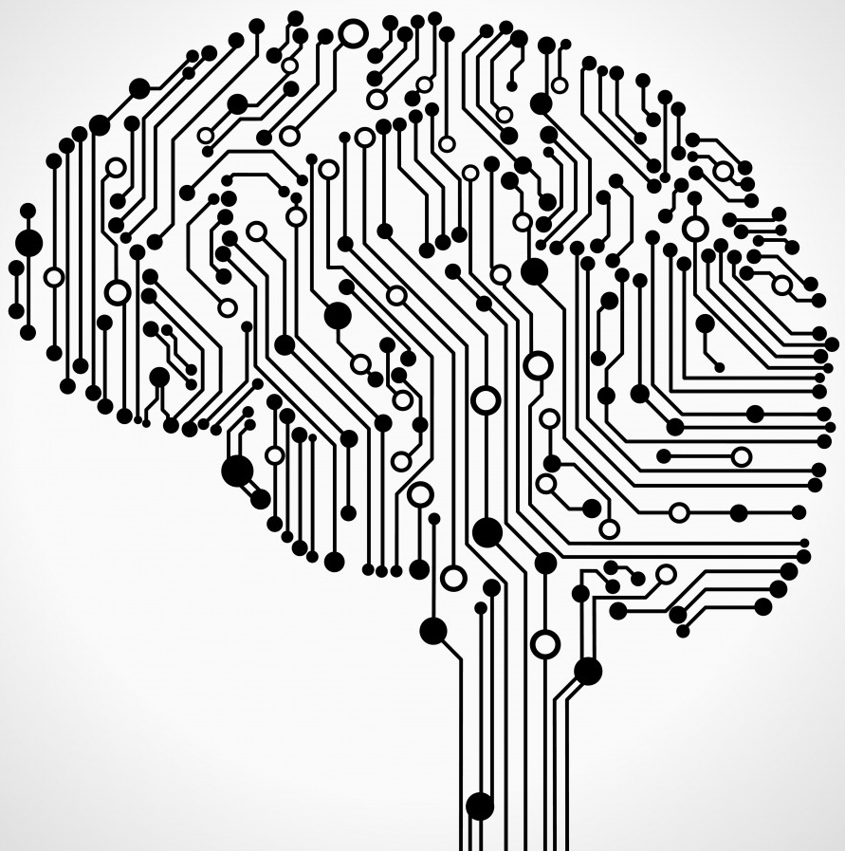
Microsoft Team Data Science Process
Phil Coachman
Cloud Solution Architect – AI
Microsoft

Slide 2
What is TDSP?
Microsoft TDSP is derived from CRISP-DM
A data science lifecycle
A standard project structure
A shared and distributed analytics infrastructure
Productivity tools and utilities
https://docs.microsoft.com/en-us/azure/machine-learning/team-data-science-process/overview

Slide 3
Data Science Lifecycle
TDSP is derived from CRISP-DM
Consists of 5 stages:
Business Understanding
Data Acquisition and Understanding
Modeling
Deployment
Customer Acceptance

Slide 4
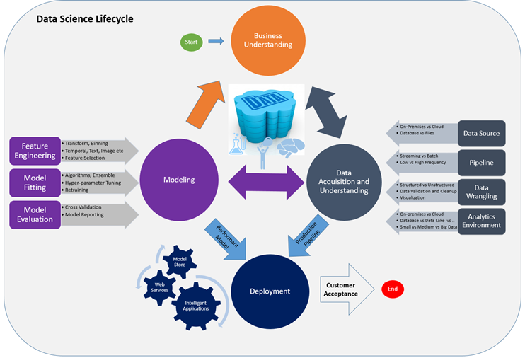

Slide 5
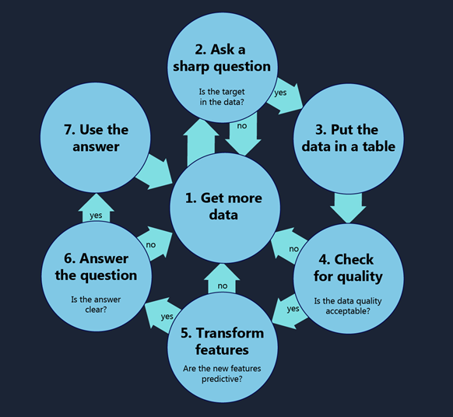
Data Science Lifecycle – Business Understanding
How to do Data Science Blog
The more precisely you ask your question the better chance you have of finding an answer you are satisfied with
Examples of poor questions are “What can my data tell me about my business?”, “What should I do?” or “How can I increase my profits?”
Clear questions like “How many Model Q Gizmos will I sell in Montreal during the third quarter?” or “Which car in my fleet is going to fail first?”
Notes:
Define Objectives: Work with your customer and other stakeholders to understand and identify the business problems. Formulate questions that define the business goals and that data science techniques can target. SMART = Specific Measurable Achievable Relevant Time-bound
How much or how many? (regression)
Which category? (classification)
Which group? (clustering)
Is this weird? (anomaly detection)
Which option should be taken? (recommendation)
Identify data sources: Find the relevant data that helps you answer the questions that define the objectives of the project.
https://github.com/Azure/Azure-TDSP-ProjectTemplate/blob/master/Docs/Project/Charter.md

Slide 6
Data Science Lifecycle – Business Understanding
Artifacts
Charter Document: A standard template is provided in the TDSP project structure definition. This is a living document that is updated throughout the project as new discoveries are made and as business requirements change. The key is to iterate upon this document, adding more detail, as you progress through the discovery process. Keep the customer and other stakeholders involved in making the changes and clearly communicate the reasons for the changes to them.
Data Sources: This is the Raw Data Sources section of the Data Definitions report that is found in the TDSP project Data Report folder. It specifies the original and destination locations for the raw data. In later stages, you fill in additional details like scripts to move the data to your analytic environment.
Data Dictionaries: This document provides descriptions of the data that is provided by the client. These descriptions include information about the schema (data types, information on validation rules, if any) and the entity-relation diagrams if available.
https://github.com/Azure/Azure-TDSP-ProjectTemplate/blob/master/Docs/Project/Charter.md
Notes:
Define Objectives: Work with your customer and other stakeholders to understand and identify the business problems. Formulate questions that define the business goals and that data science techniques can target. SMART = Specific Measurable Achievable Relevant Time-bound
How much or how many? (regression)
Which category? (classification)
Which group? (clustering)
Is this weird? (anomaly detection)
Which option should be taken? (recommendation)
Identify data sources: Find the relevant data that helps you answer the questions that define the objectives of the project.
https://github.com/Azure/Azure-TDSP-ProjectTemplate/blob/master/Docs/Project/Charter.md

Slide 7
Data Science Lifecycle – Data Acquisition and Understanding
Artifacts
Data Quality Report: This report contains data summaries, relationships between each attribute and target, variable ranking etc. The IDEAR tool provided as part of TDSP can quickly generate this report on any tabular dataset such as a CSV file or a relational table.
Solution Architecture: This can be a diagram or description of your data pipeline used to run scoring or predictions on new data once you have built a model. It also contains the pipeline to retrain your model based on new data. The document is stored in the Project directory when using the TDSP directory structure template.
Checkpoint Decision: Before you begin full feature engineering and model building, you can reevaluate the project to determine whether the value expected is sufficient to continue pursing it. You may, for example, be ready to proceed, need to collect more data, or abandon the project as the data does not exist to answer the question.
Notes:
Goals
A clean, high-quality dataset whose relations to the target variables are understood that are located in the appropriate analytics environment, ready to model.
A solution architecture of the data pipeline to refresh and score data regularly has been developed.
Ingest the data into the target analytic environment.
Explore the data to determine if the data quality is adequate to answer the question.
Set up a data pipeline to score new or regularly refreshed data.
https://github.com/Azure/Azure-TDSP-Utilities/tree/master/DataScienceUtilities/DataReport-Utils
https://github.com/Azure/Azure-TDSP-Utilities/blob/master/DataScienceUtilities/DataReport-Utils/Python/IDEAR-Python-Instructions-JupyterNotebook.md

Slide 8
Data Science Lifecycle – Modeling
Artifacts
Feature Sets: The features developed for the modeling are described in the Feature Sets section of the Data Definition report. It contains pointers to the code to generate the features and description on how the feature was generated.
Model Report: For each model that is tried, a standard, template-based report that provides details on each experiment is produced.
Checkpoint Decision: Evaluate whether the model is performing well enough to deploy it to a production system. Some key questions to ask are:
Does the model answer the question with sufficient confidence given the test data?
Should try any alternative approaches: collect additional data, do more feature engineering, or experiment with other algorithms?
https://github.com/Azure/Azure-TDSP-Utilities
Notes:
Goals
Optimal data features for the machine learning model.
An informative ML model that predicts the target most accurately.
An ML model that is suitable for production.
How to do it
There are three main tasks addressed in this stage:
Feature Engineering: create data features from the raw data to facilitate model training.
Model training: find the model that answers the question most accurately by comparing their success metrics.
Determine if your model is suitable for production.
https://github.com/Azure/Azure-TDSP-ProjectTemplate/blob/master/Docs/Model/Model%201/Model%20Report.md

Slide 10
Data Science Lifecycle – Deployment
Artifacts
Status dashboard of system health and key metrics.
Final modeling report with deployment details.
Final solution architecture document.
Notes:
Goal
Models with a data pipeline are deployed to a production or production-like environment for final user acceptance.
How to do it
Operationalize the model: Deploy the model and pipeline to a production or production-like environment for application consumption.
https://docs.microsoft.com/en-us/azure/machine-learning/team-data-science-process/walkthroughs

Slide 11
Data Science Lifecycle – Customer Acceptance
Artifacts
Exit Report of Project for Customer
Sample Template:
https://github.com/Azure/Azure-TDSP-ProjectTemplate/blob/master/Docs/Project/Exit%20Report.md
Notes:
Goal
Finalize the project deliverables: confirm that the pipeline, the model, and their deployment in a production environment are satisfying customer objectives.
How to do it
System validation: confirm the deployed model and pipeline are meeting customer needs.
Project hand-off: to the entity that is to run the system in production.
https://aka.ms/TDSP_ER

Slide 12
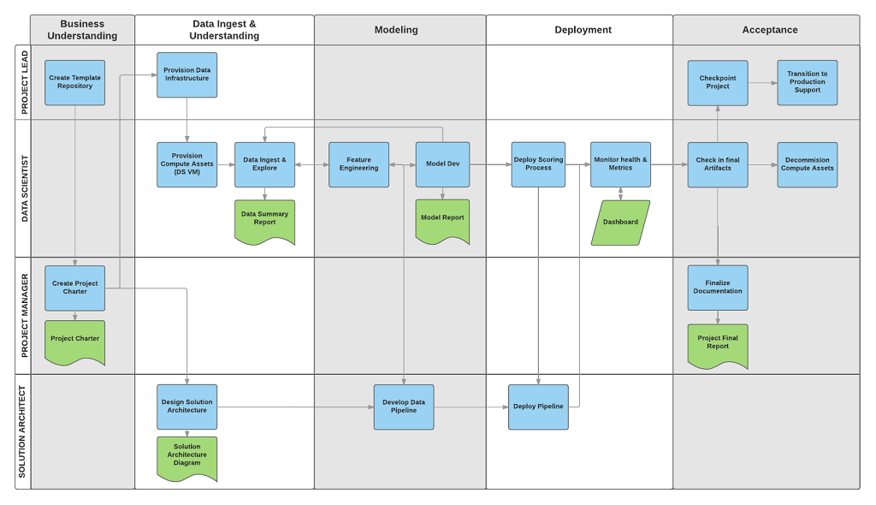
Data Science Lifecycle by Role
Notes:
Goal
Finalize the project deliverables: confirm that the pipeline, the model, and their deployment in a production environment are satisfying customer objectives.
How to do it
System validation: confirm the deployed model and pipeline are meeting customer needs.
Project hand-off: to the entity that is to run the system in production.
https://aka.ms/TDSP_ER

Slide 13
Project Structure - Roles
Definition of four TDSP roles
Group Manager. Group Manager is the manager of the entire data science unit in an enterprise. A data science unit might have multiple teams, each of which is working on multiple data science projects in distinct business verticals. A Group Manager might delegate their tasks to a surrogate, but the tasks associated with the role do not change.
Team Lead. A team lead is managing a team in the data science unit of an enterprise. A team consists of multiple data scientists. For data science unit with only a small number of data scientists, the Group Manager and the Team Lead might be the same person.
Project Lead. A project lead manages the daily activities of individual data scientists on a specific data science project.
Project Individual Contributor. Data Scientist, Business Analyst, Data Engineer, Architect, etc. A project individual contributor executes a data science project.

Slide 14
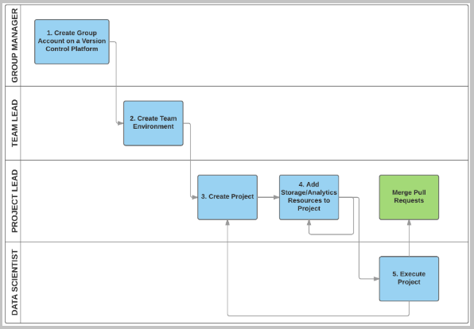
Project Structure - Responsibilities

Slide 15
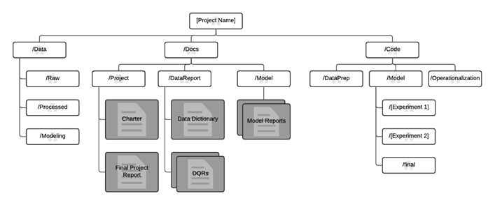
Project Structure – Source Repo
Notes:
https://github.com/Azure/Azure-TDSP-ProjectTemplate

Slide 16
Tools & Utilities
Microsoft has developed several tools internally to work through the TDSP.
Interactive Data Exploration, Analysis, and Reporting (IDEAR) in R.
Interactive Data Exploration, Analysis, and Reporting (IDEAR) in MRS.
Interactive Data Exploration, Analysis, and Reporting (IDEAR) in Python.
Automated Modeling and Reporting in R (AMAR in R)
https://github.com/Azure/Azure-TDSP-Utilities
Notes:
TDSP provides an initial set of tools and scripts to jump-start adoption of TDSP within a team. It also helps automate some of the common tasks in the data science lifecycle such as data exploration and baseline modeling

Slide 17
Shared Analytics
TDSP provides recommendations for managing shared analytics and storage infrastructure such as:
cloud file systems for storing datasets
databases
big data (Hadoop or DataBricks) clusters
machine learning services
Notes:
The analytics and storage infrastructure can be in the cloud or on-premises. This is where raw and processed datasets are stored. This infrastructure enables reproducible analysis. It also avoids duplication, which can lead to inconsistencies and unnecessary infrastructure costs. Tools are provided to provision the shared resources, track them, and allow each team member to connect to those resources securely. It is also a good practice have project members create a consistent compute environment. Different team members can then replicate and validate experiments.

Slide 18
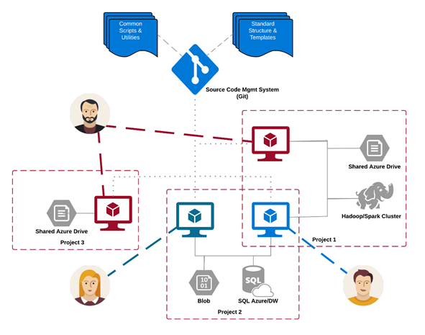
Notes:
The analytics and storage infrastructure can be in the cloud or on-premises. This is where raw and processed datasets are stored. This infrastructure enables reproducible analysis. It also avoids duplication, which can lead to inconsistencies and unnecessary infrastructure costs. Tools are provided to provision the shared resources, track them, and allow each team member to connect to those resources securely. It is also a good practice have project members create a consistent compute environment. Different team members can then replicate and validate experiments.

Slide 19
AzureML https://docs.microsoft.com/en-us/azure/machine-learning/
Team Data Science Process https://docs.microsoft.com/en-us/azure/machine-learning/team-data-science-process/
AzureML CI\CD https://docs.microsoft.com/en-us/azure/machine-learning/team-data-science-process/ci-cd-flask
Azure DataBricks https://docs.microsoft.com/en-us/azure/azure-databricks/what-is-azure-databricks

